Slide 1
Chapter 3 Convolution Representation
§3-1 Convolution Representation of Linear Time-invariant Discrete-Time Systems
§3-2 Convolution of Discrete-Time Signals
Problems

Slide 2
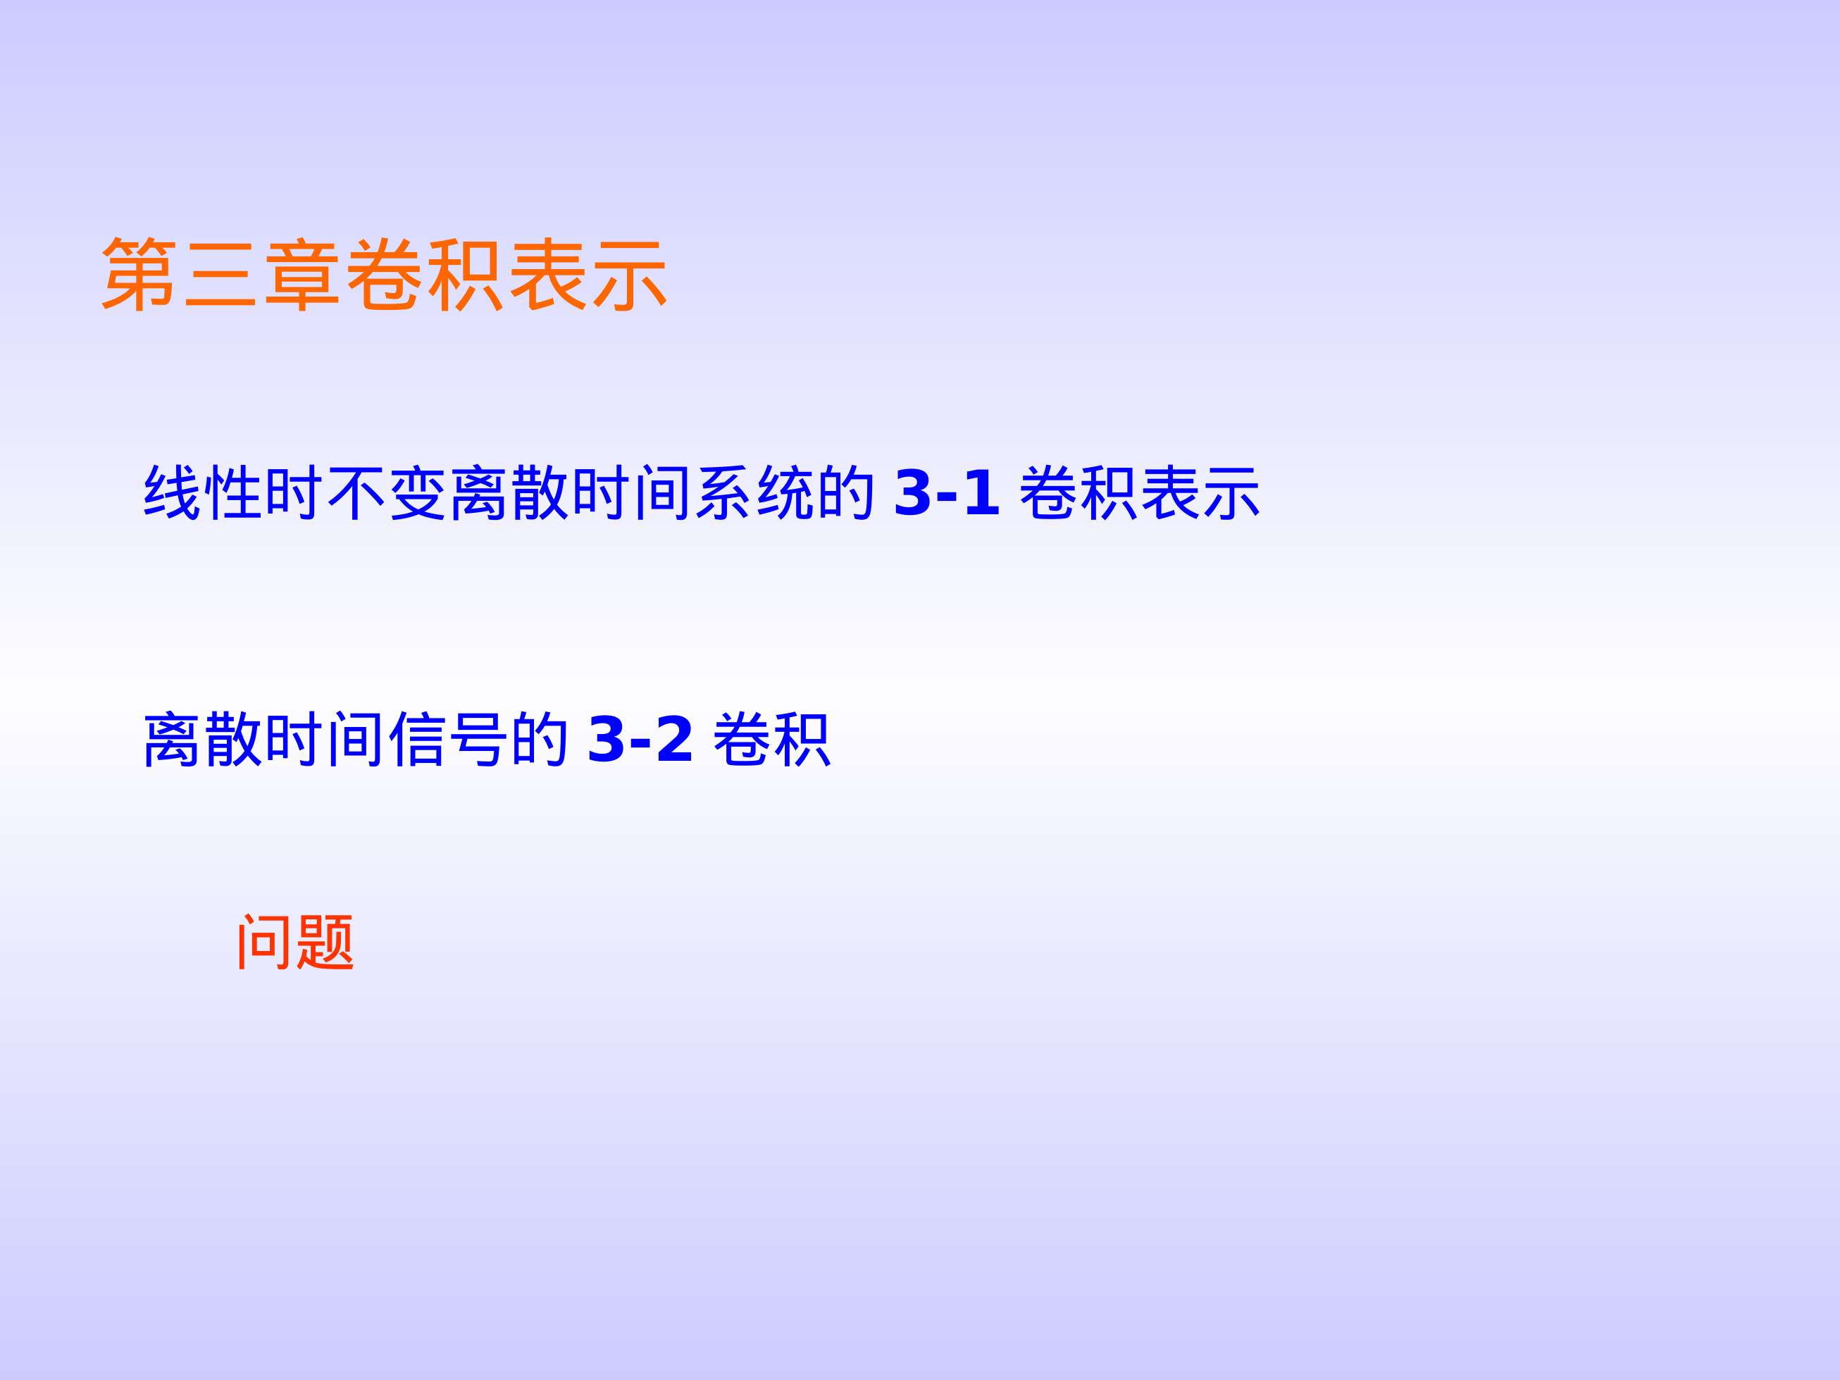

Slide 3
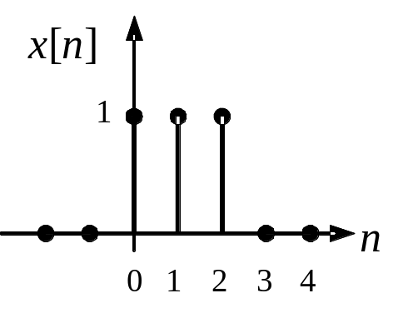
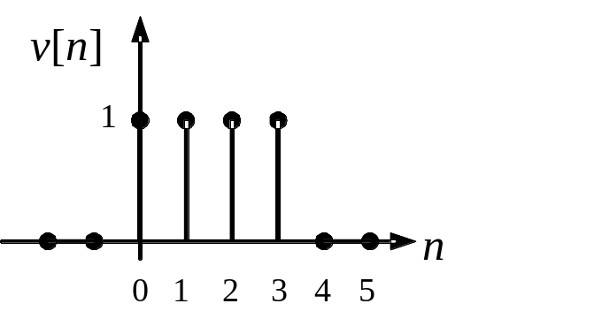
Problems
3.1 For the discrete-time signal x[n] and v[n] shown below, compute the convolution x[n]∗v[n] for all n≥0. Sketch the result.
3.2 Given the discrete-time signal x[n] and v[n]:
x[n]=1 for –1≤n≤2 and x[n]=0 for all other integers n;
v[–1]=1, v[0]=2, v[1]=3, v[2]=2, v[3]=1 and v[n]=0 for all other integers n.
Compute x[n]∗v[n] for n≥–2.

Slide 4
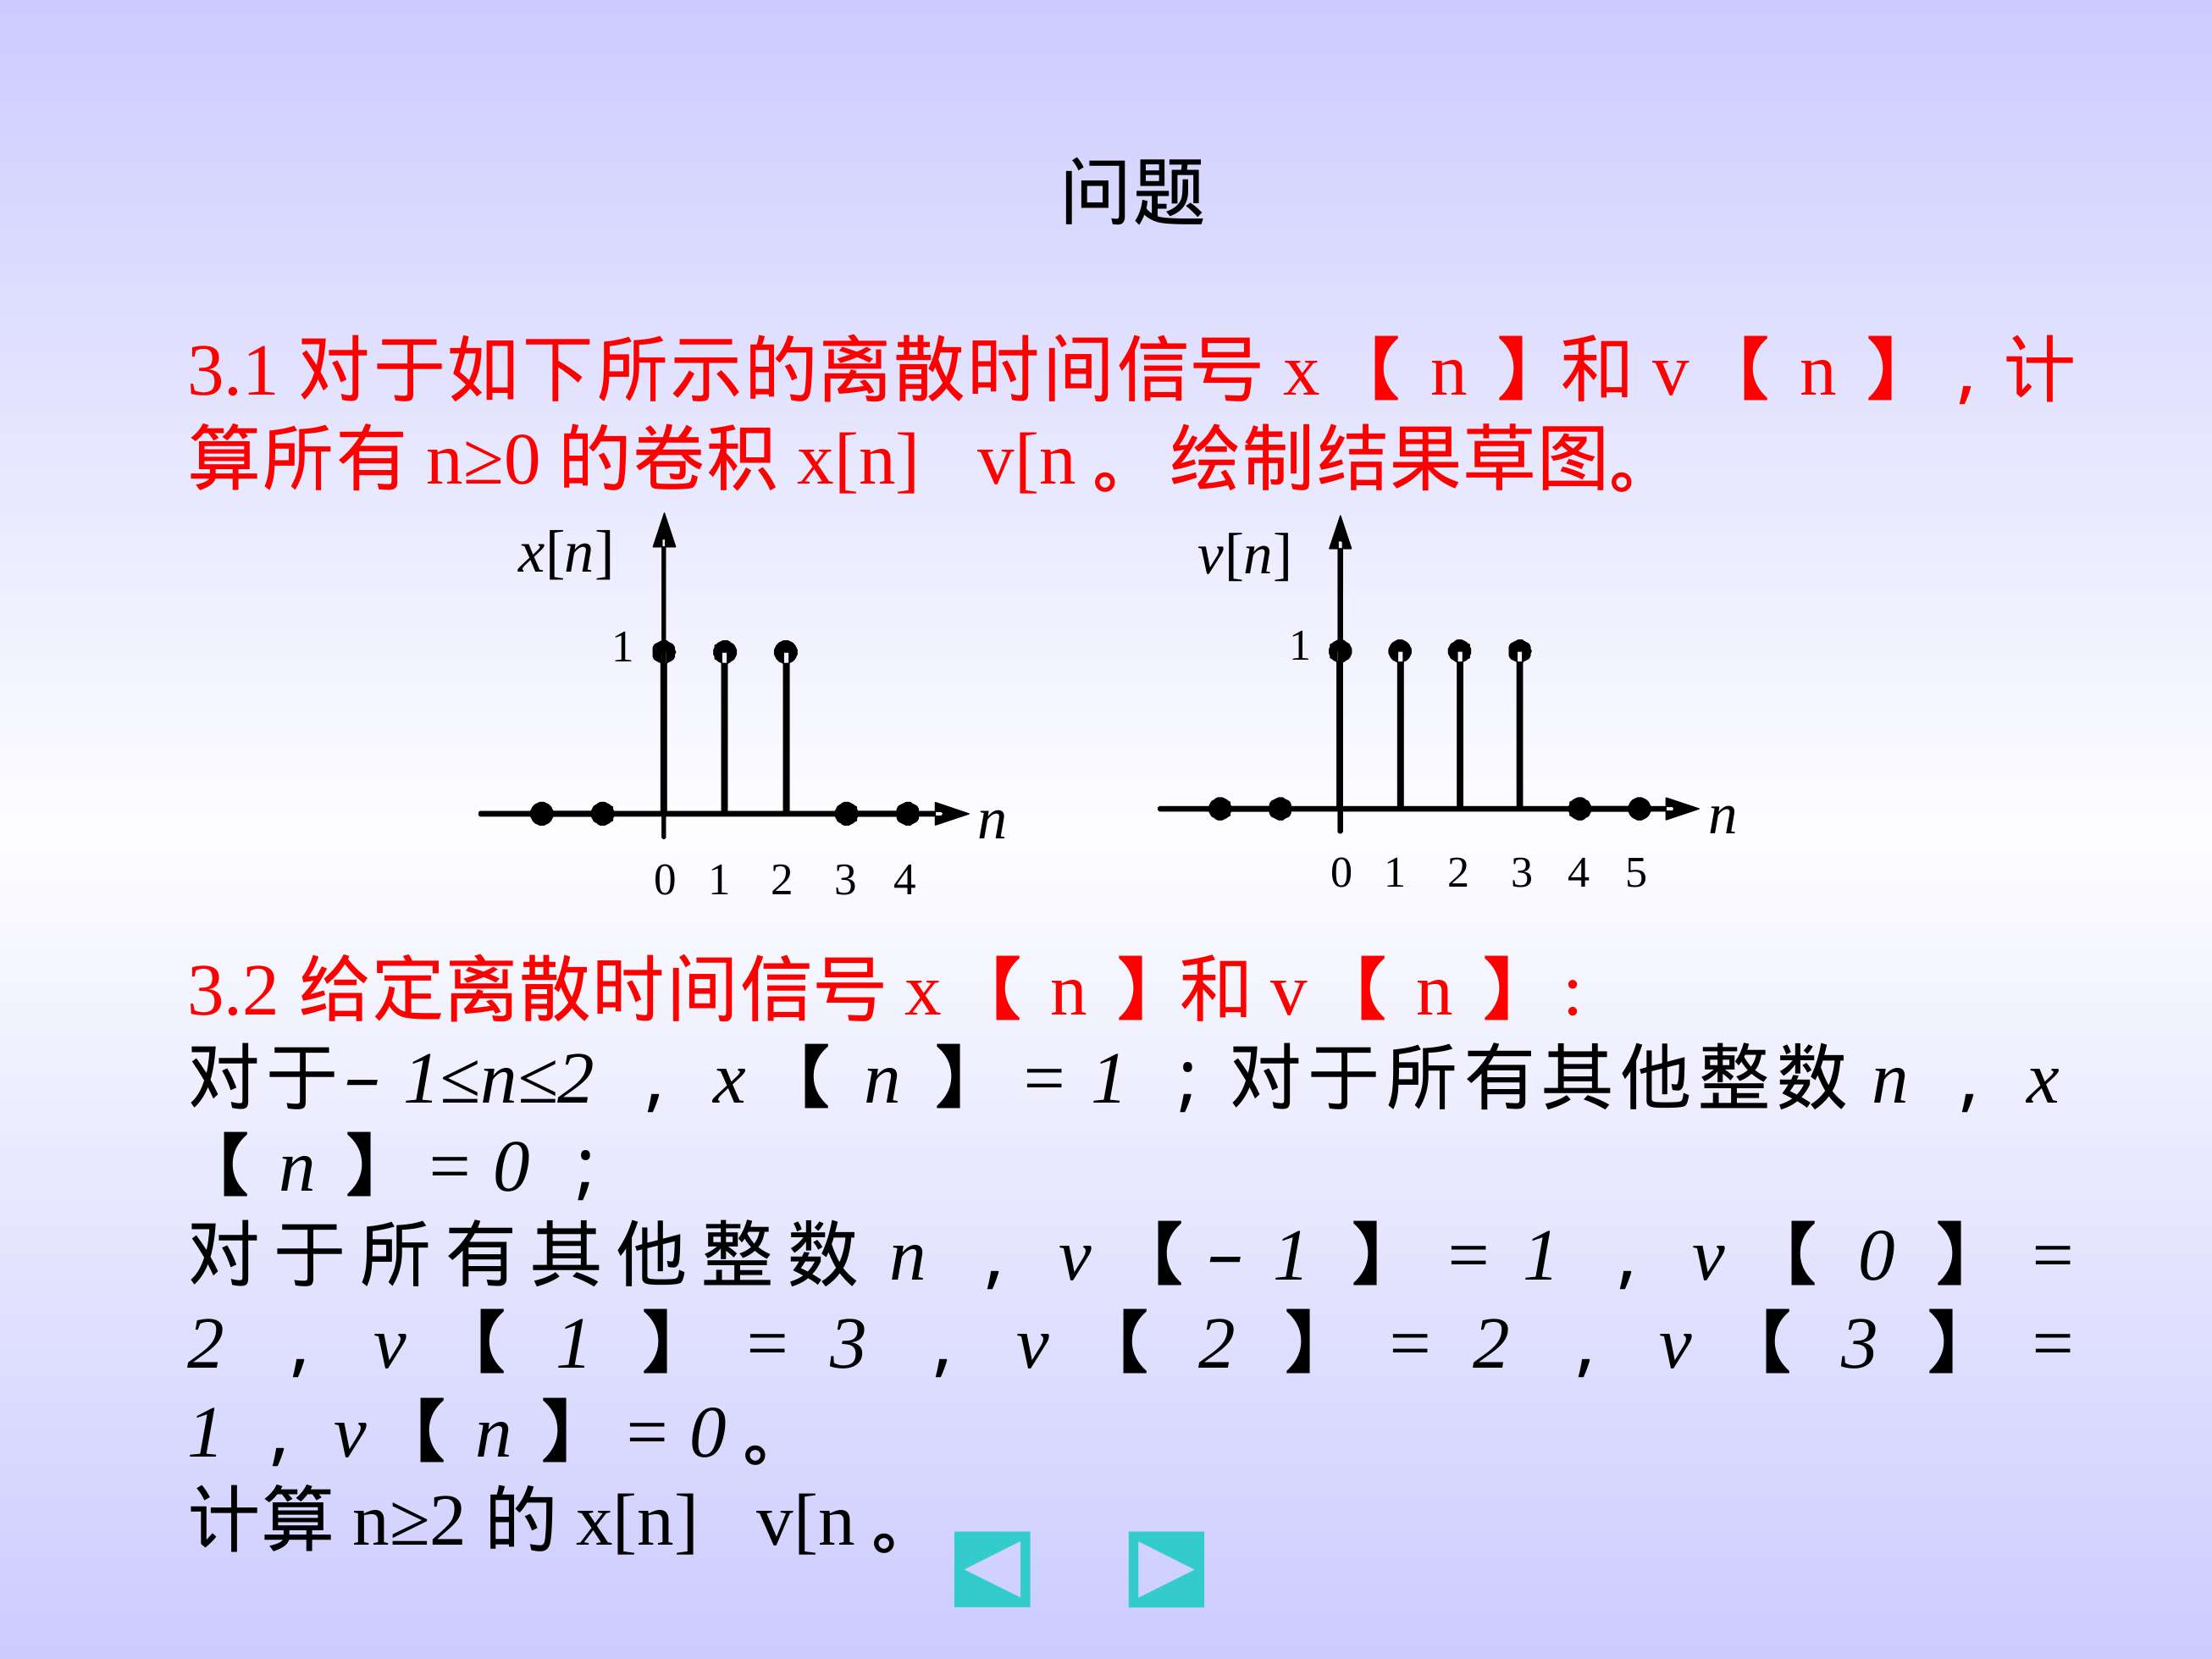

Slide 5
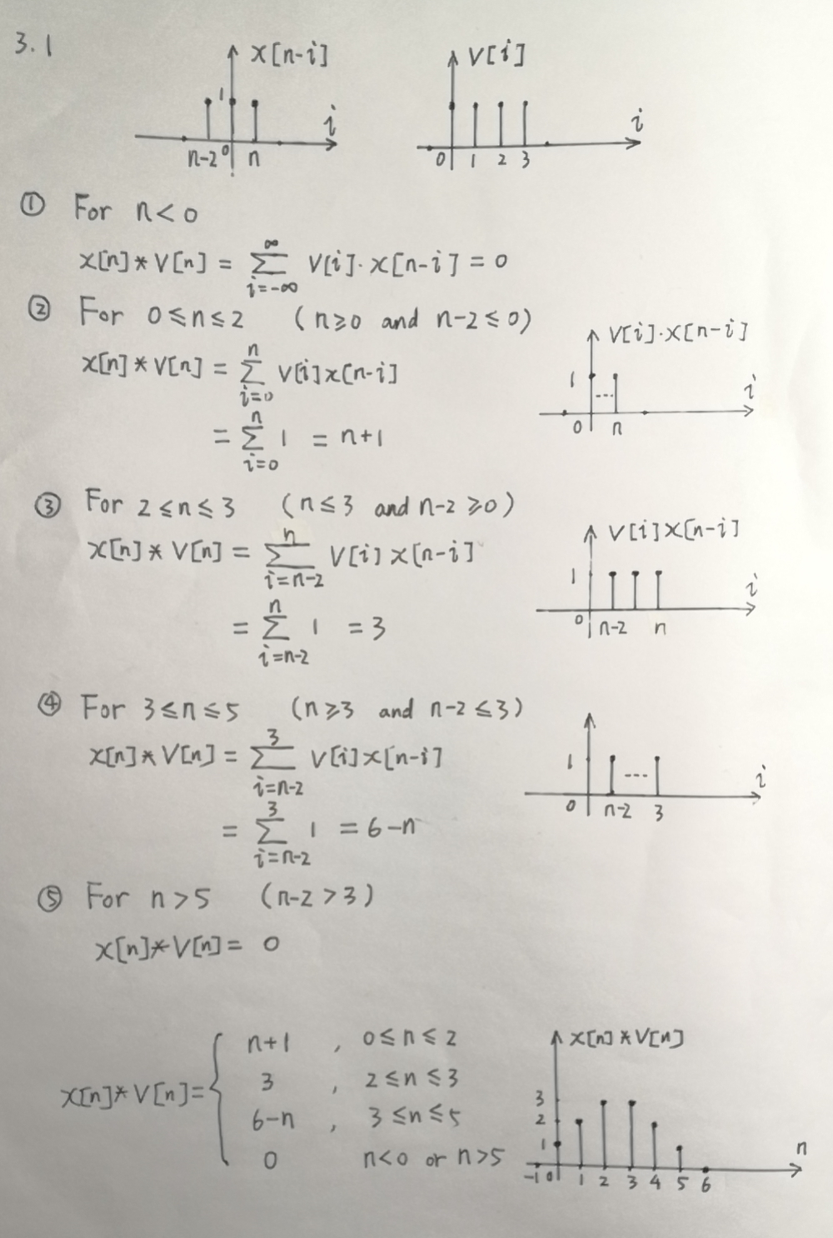
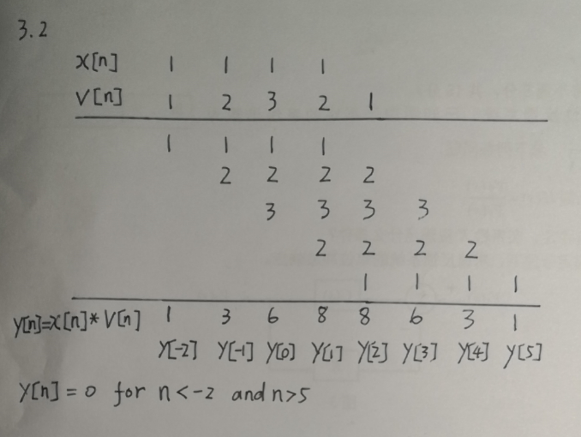

Slide 6
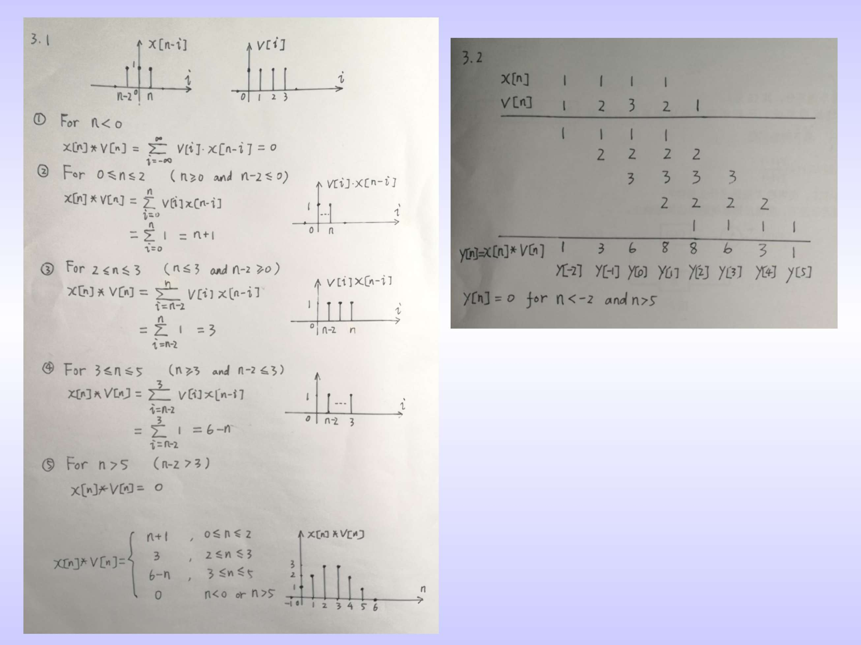

Slide 7
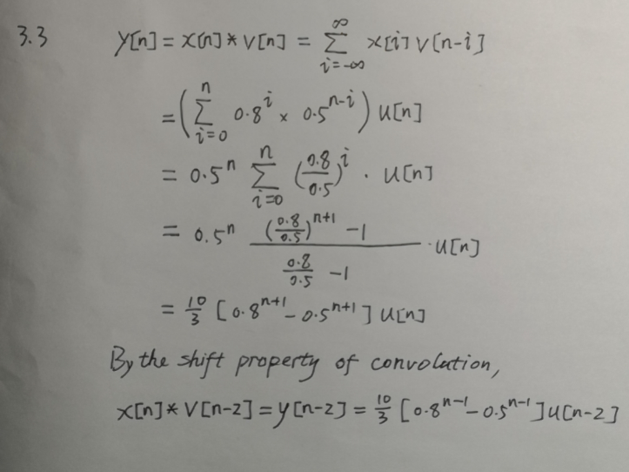
3.3 Given v[n]=(0.8)^{n}u[n] and x[n]=(0.5)^{n}u[n], compute x[n]∗v[n] and x[n]∗v[n–2].

Slide 8
